Slide 1
Original Proposed Content
Title: Effective Data Visualization for Actuaries
Session Description:
Actuaries often need to regularly communicate trends, diagnostics, and findings to stakeholders (other actuaries, their business partners, or clients).
Two questions arise:
How do we create visualizations that let actuaries focus on interpreting rather than doing?
How do we re-structure these visualizations to tell a better story?
In this session Brian and I will examine some common actuarial analysis problems (e.g. loss development, trend/inflation, mix shift exhibits, and model diagnostics) through the lens of visualization. Using R’s `ggplot2` package, we’ll show how these visualizations can be improved to better communicate the story. For example, reserve loss development can be manipulated with `dplyr` to show cumulative losses on the x-axis and incremental amounts on the y-axis to better highlight the loss development factor. After demoing a few visualization examples, we’ll show how some formatting tricks can be used to make your visualizations look polished.
Learning Objectives:
Demonstrate when alternative representations of common actuarial visualizations are helpful
Basic use of the `ggplot2` package
When and how to use non-data formatting to customize a visualization for your audience
Session Format: Concurrent Session, 50-60 minutes
Theme: Navigate
Applicable Areas: Actuarial Toolkit: Programming Software, Data Manipulation Tools, and Data Visualization Tools
Knowledge Level: Level 2: General Knowledge of the Subject (6-9 years)
Interactive Elements: There will be one or two discussion prompts, as well live voting to compare different means of visualizing data analysis
To Be Removed. For Reference Only.

Slide 2
Effective Data Visualization for Actuaries
Brian Fannin
Jordan Bonner

Slide 3
Effective Data Visualization for Actuaries
Brian Fannin
Jordan Bonner

Slide 4
Antitrust Notice
The Casualty Actuarial Society is committed to adhering strictly to the letter and spirit of the antitrust laws. Seminars conducted under the auspices of the CAS are designed solely to provide a forum for the expression of various points of view on topics described in the programs or agendas for such meetings.
Under no circumstances shall CAS seminars be used as a means for competing companies or firms to reach any understanding – expressed or implied – that restricts competition or in any way impairs the ability of members to exercise independent business judgment regarding matters affecting competition.
It is the responsibility of all seminar participants to be aware of antitrust regulations, to prevent any written or verbal discussions that appear to violate these laws, and to adhere in every respect to the CAS antitrust compliance policy.

Slide 5
Visualizations should:
Be Easily Interpreted
Tell a Story

Slide 6
Agenda
Data Storytelling
Actuarial Visualization
Automating Actuarial Exhibits

Slide 7
Icebreaker Examples
A slide or two that are difficult to interpret, then a slide or two that are easy to interpret?

Slide 8
Revisiting common Actuarial Exhibits

Slide 9
Common Actuarial Exhibits
Loss Development Triangles
Trend Selection
Rate Indications
Mix Shift Exhibits
Model Diagnostics

Slide 10
Loss Development Triangles

Slide 11
Loss Development Triangles

Slide 12
Trend Selection

Slide 13
Trend Selection

Slide 14
Rate Indications

Slide 15
Rate Indications

Slide 16
Mix Shift

Slide 17
Mix Shift

Slide 18
Model Diagnostics

Slide 19
Model Diagnostics

Slide 20
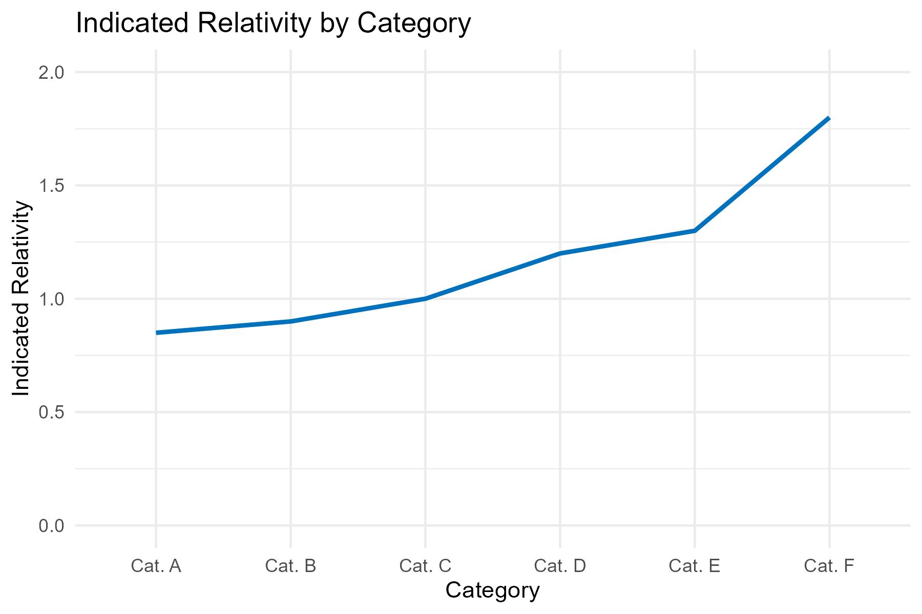
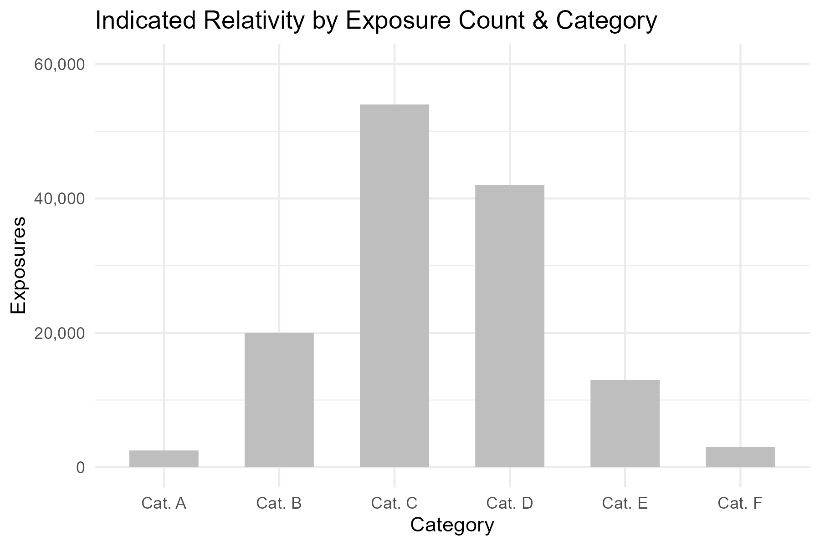
Two Axes vs Two Charts

Slide 21
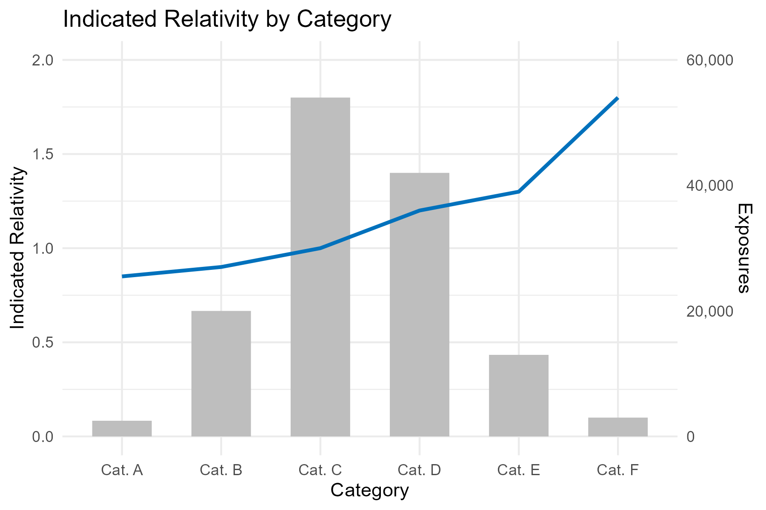
Two Axes vs Two Charts

Slide 22
Automating Actuarial Exhibits

Slide 23
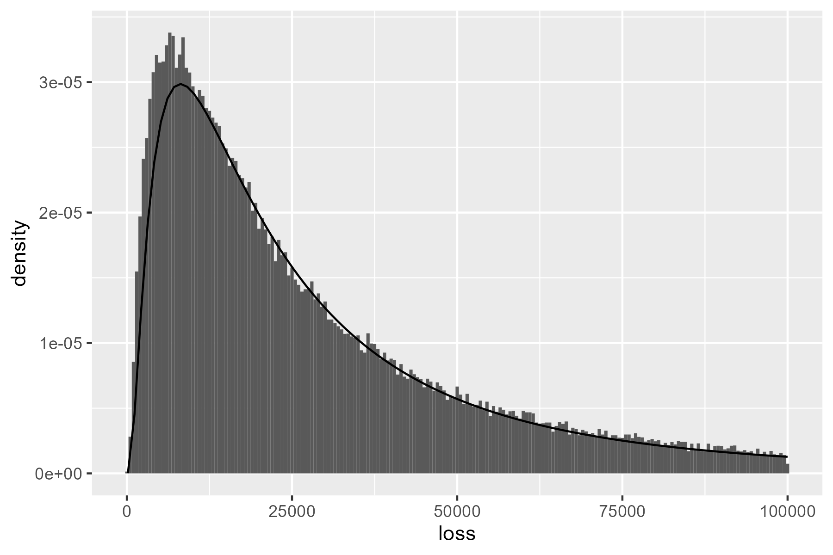
Initial Example: Fitted Severity
How can we improve upon this chart?
P <- data |>
geom_histogram(aes(x = loss, after_stat(density)) +
stat_function(fun = dlnorm,
args = list(meanlog = 10, sdlog = 1.0))

Slide 24
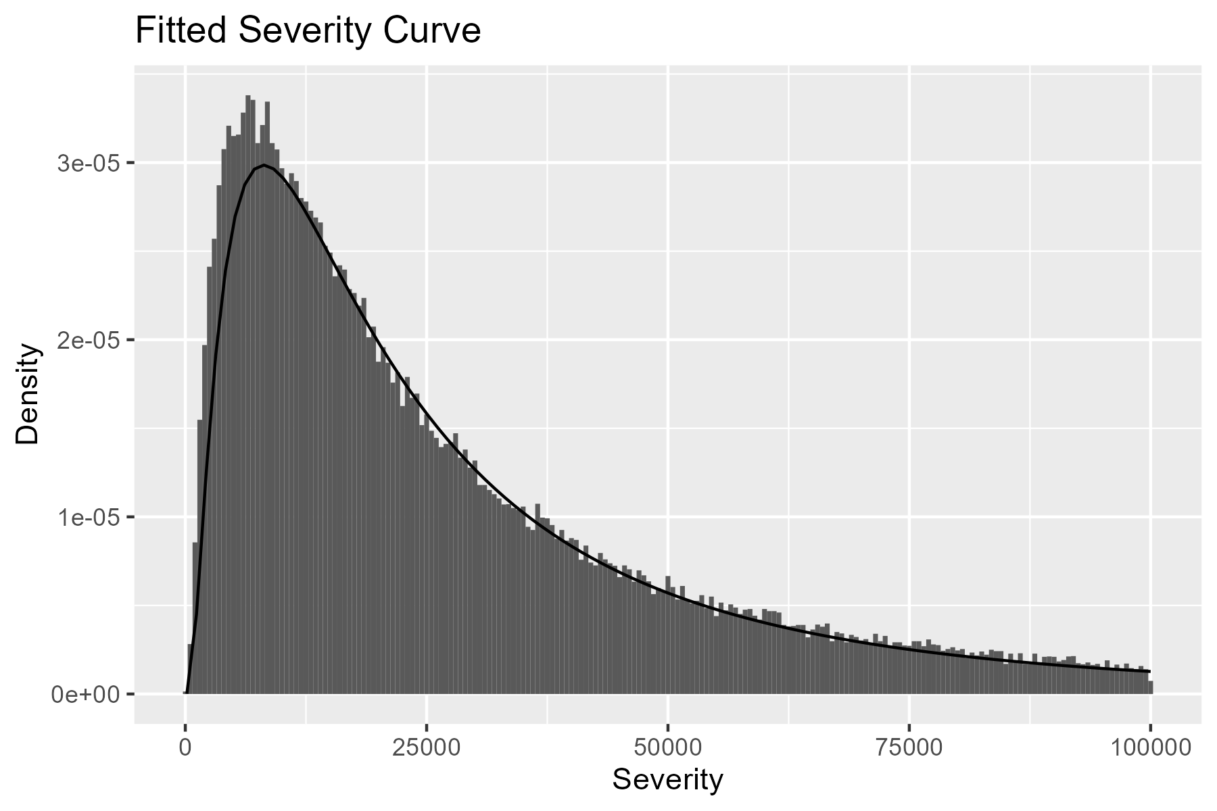
Titles & Renaming Variables
Adding a title and variable names goes a long way.
P <- p +
labs(
x = "Severity",
y = "Density",
title = "Fitted Severity Curve"
)

Slide 25
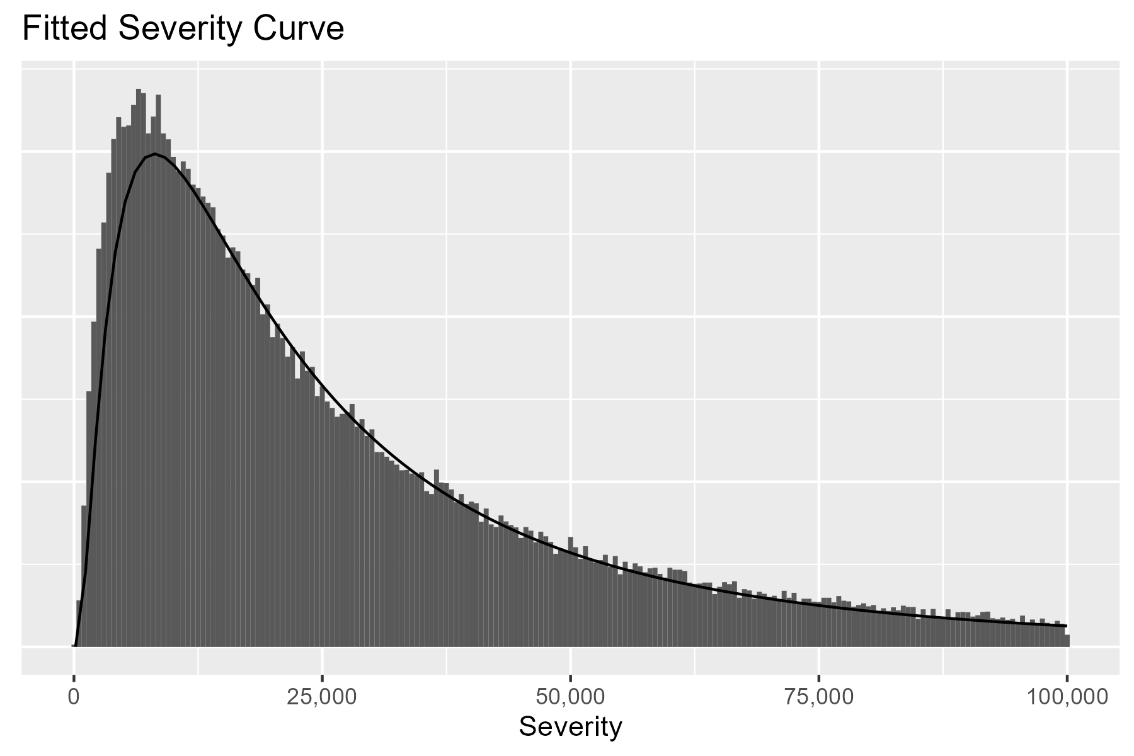
Cleaning Axes
We can change the x-axis labels and remove the y-axis.
P <- p +
scale_x_continuous(labels = scales::comma) +
theme(axis.text.y = element_blank(),
axis.ticks.y = element_blank(),
axis.title.y = element_blank())

Slide 26
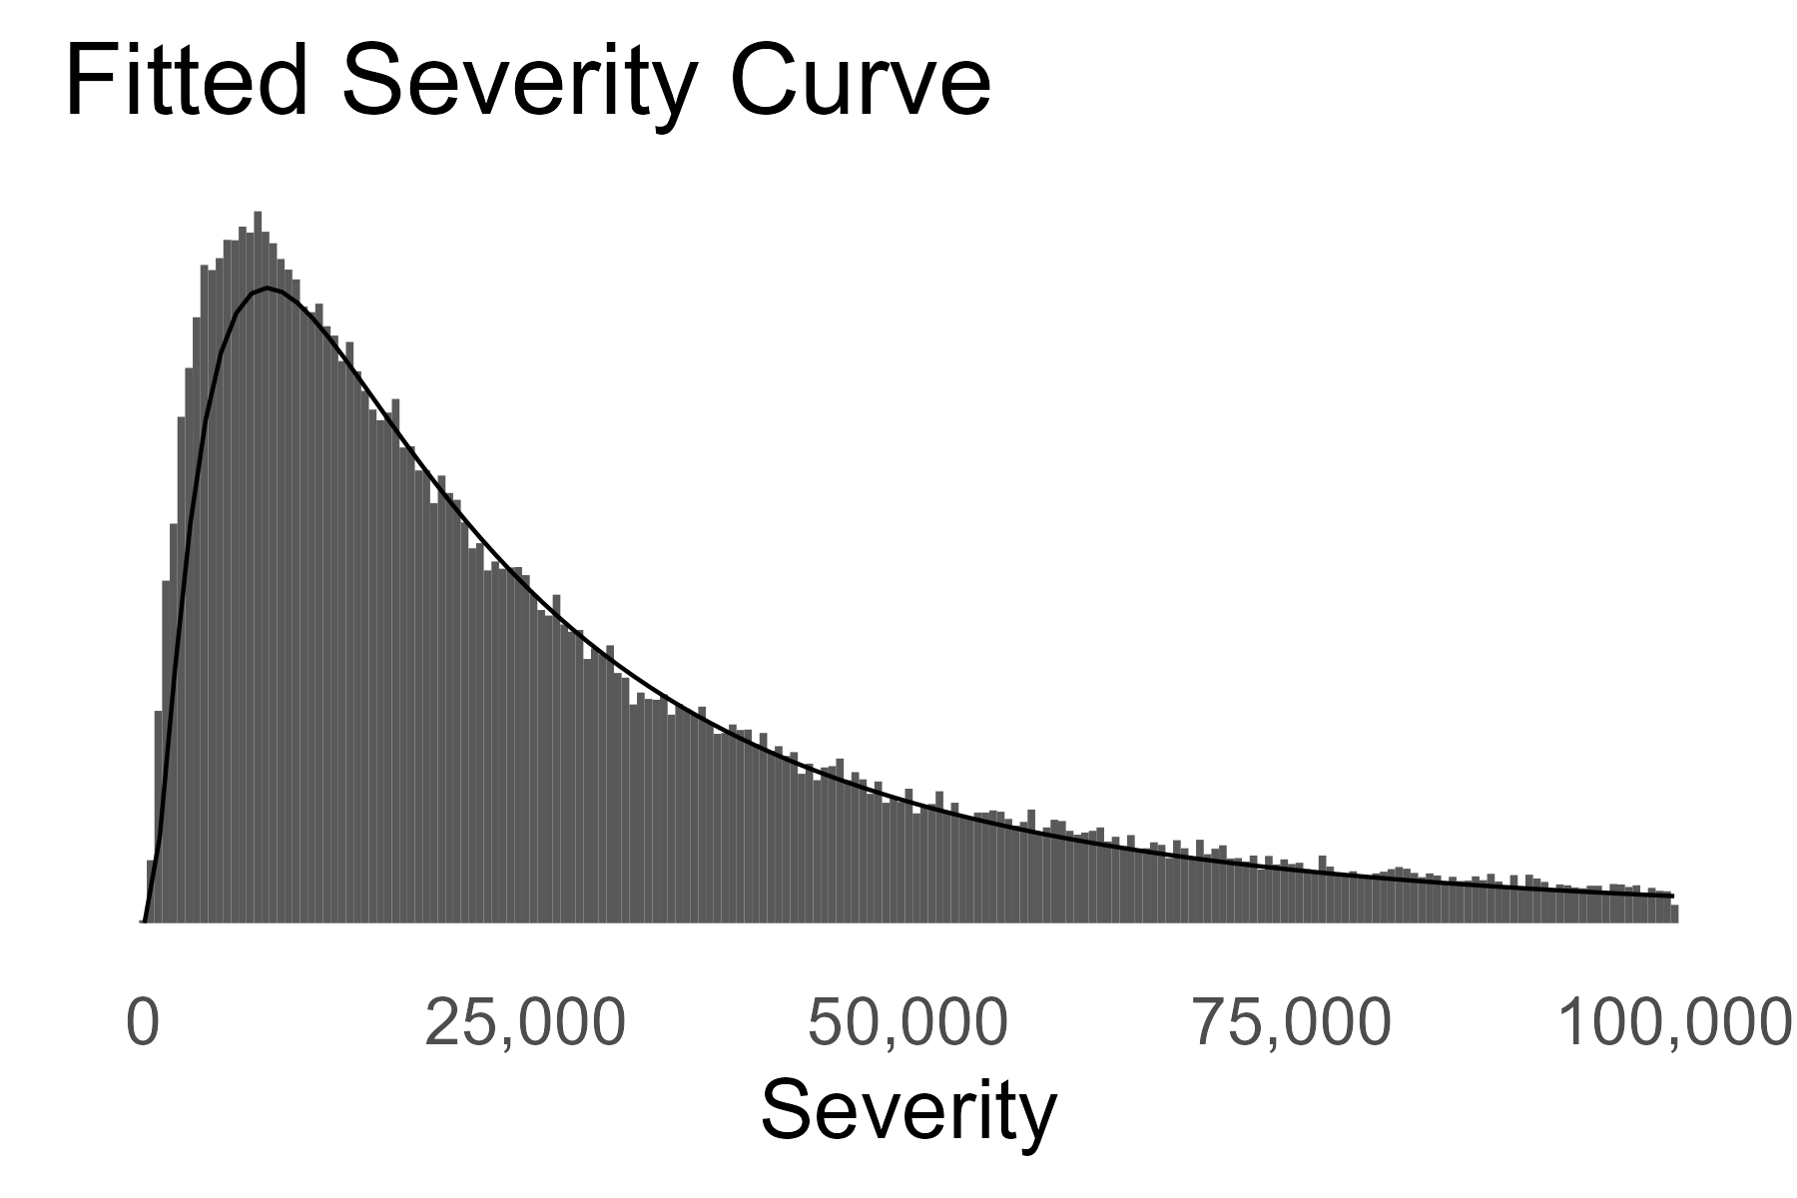
Text Size & Theme
We can increase text size and select a simpler theme.
P <- p +
theme_minimal(base_size = 20) +
theme(panel.grid.major = element_blank(),
panel.grid.minor = element_blank()) +
scale_x_continuous(labels = scales::comma) +
theme(axis.text.y = element_blank(),
axis.ticks.y = element_blank(),
axis.title.y = element_blank())

Slide 27
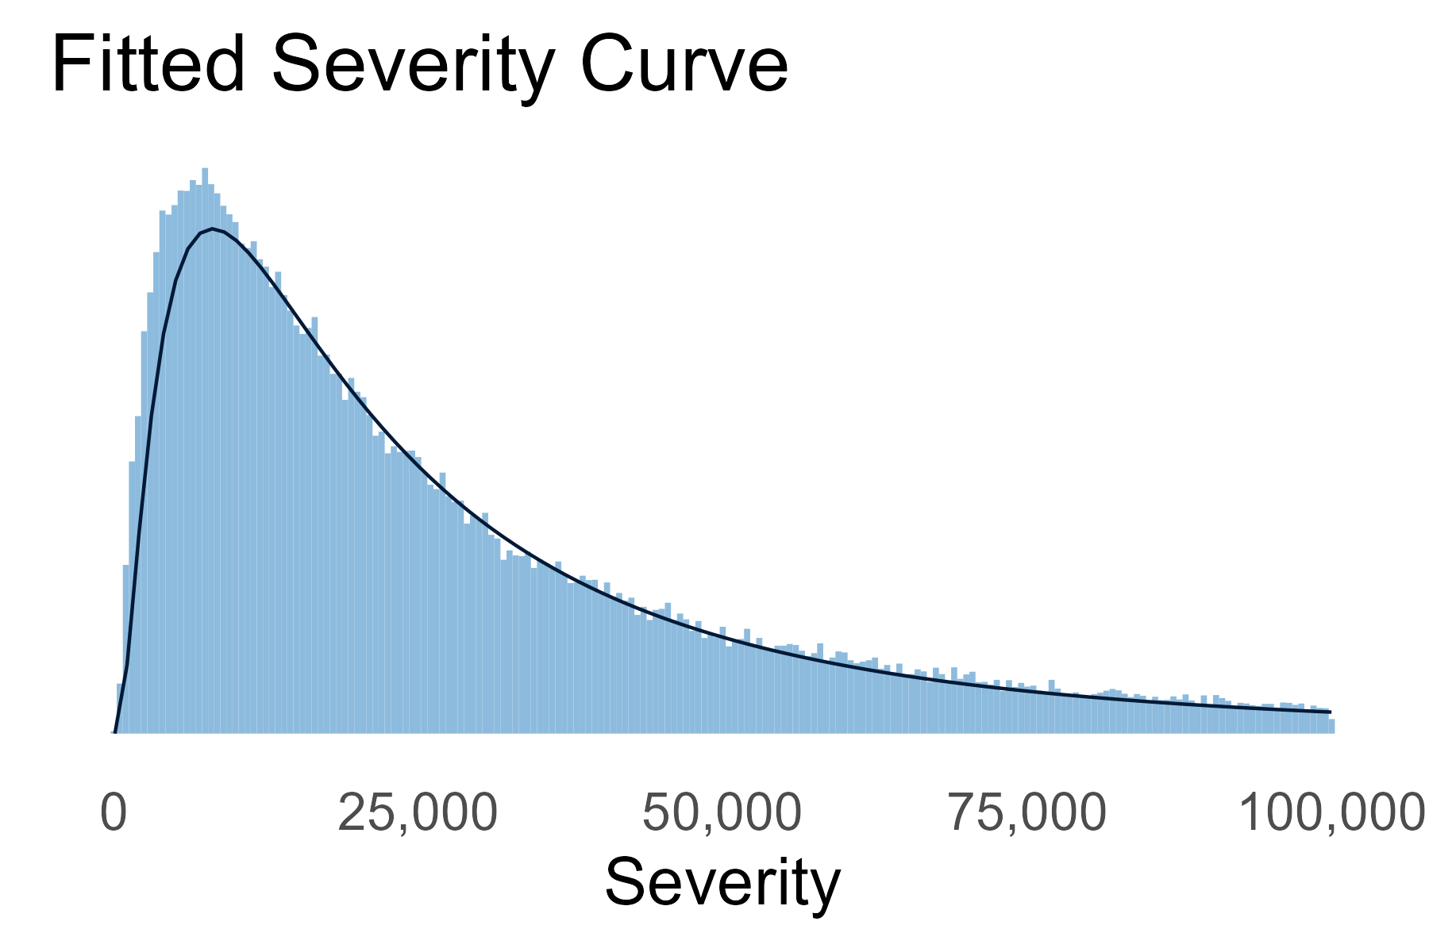
Color
We can also update the color, if desired.
...
geom_histogram(aes(x = loss, after_stat(density)),
fill = pal_CAS["light_blue"]) +
stat_function(fun = dlnorm,
args = list(meanlog = 10, sdlog = 1.0),
color = pal_CAS["dark_blue"]) +
...

Slide 28
Comparison

Slide 29
Practical formatting tricks

Slide 30
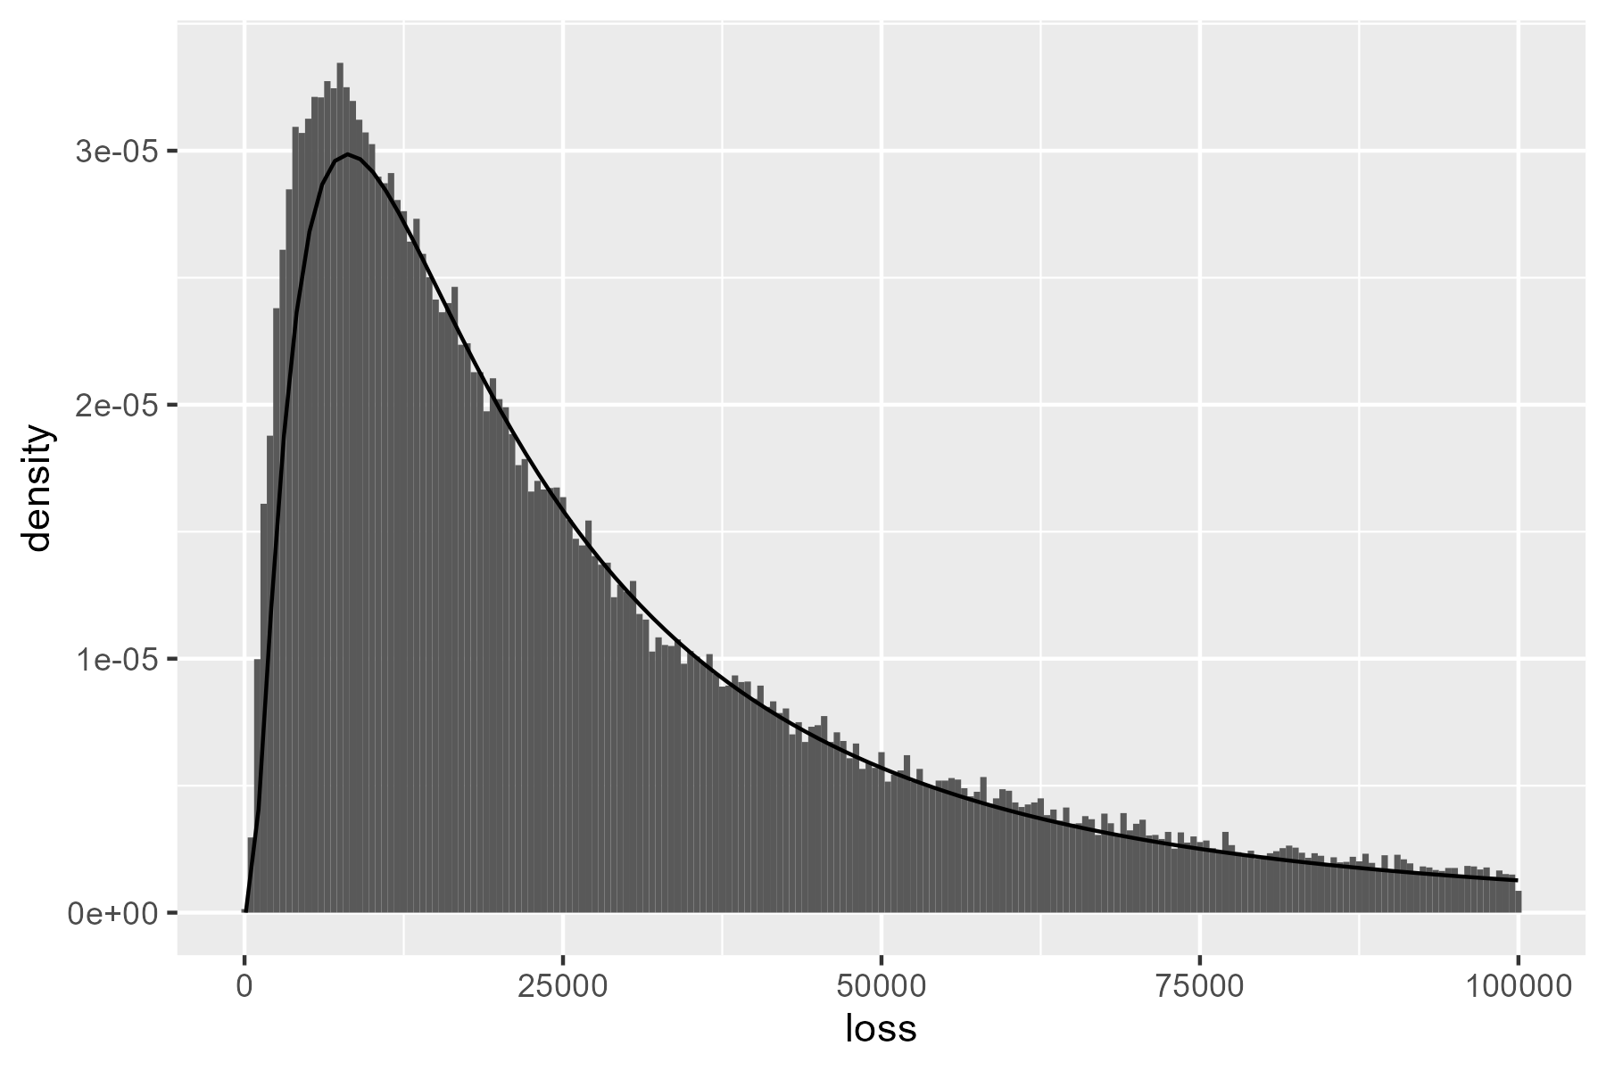
Initial Example: Fitted Severity
How can we improve upon this chart?
P <- data |>
geom_histogram(aes(x = loss, after_stat(density)) +
stat_function(fun = dlnorm,
args = list(meanlog = 10, sdlog = 1.0))

Slide 31
Titles & Renaming Variables
Adding a title and variable names goes a long way.
P <- p +
labs(
x = "Severity",
y = "Density",
title = "Fitted Severity Curve"
)

Slide 32
Appendix

Slide 33
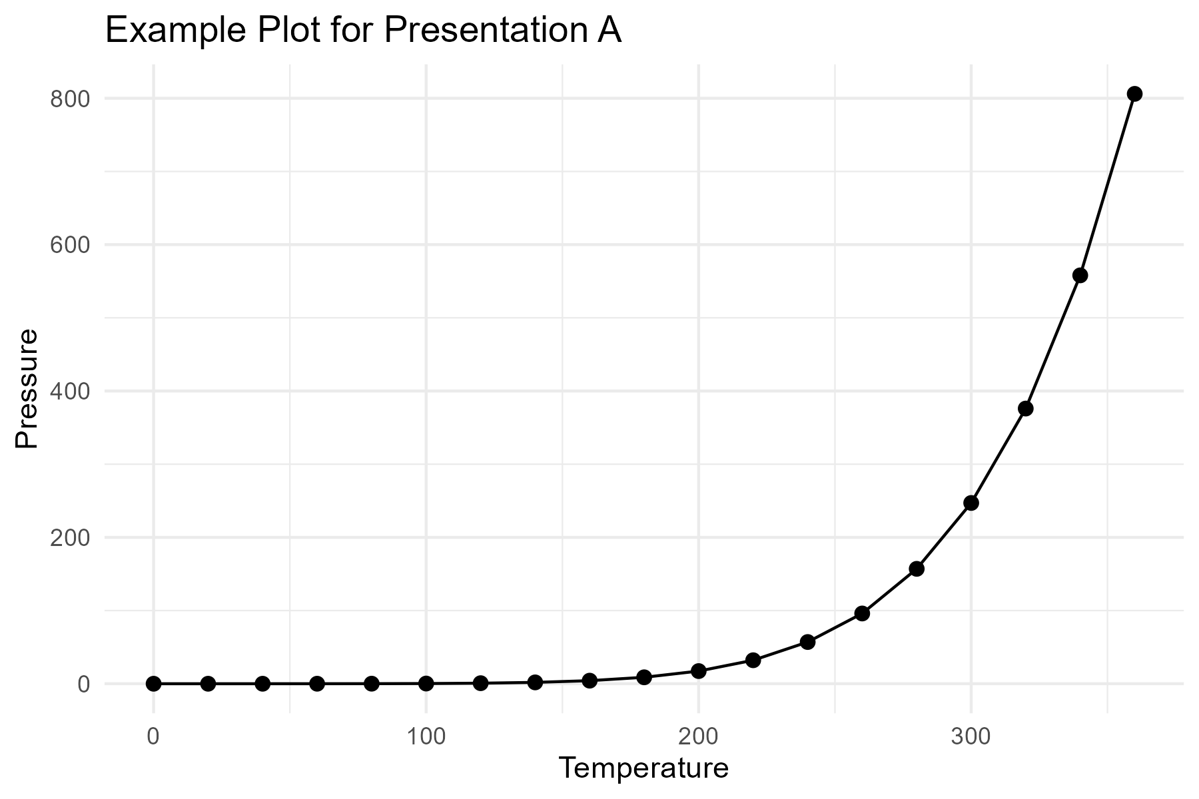
Example Plot A

Slide 34
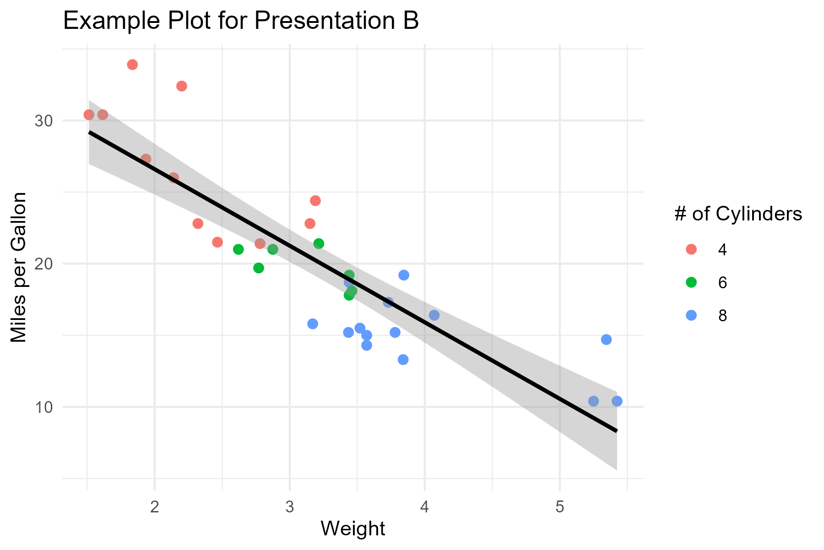
Example Plot B

Slide 35
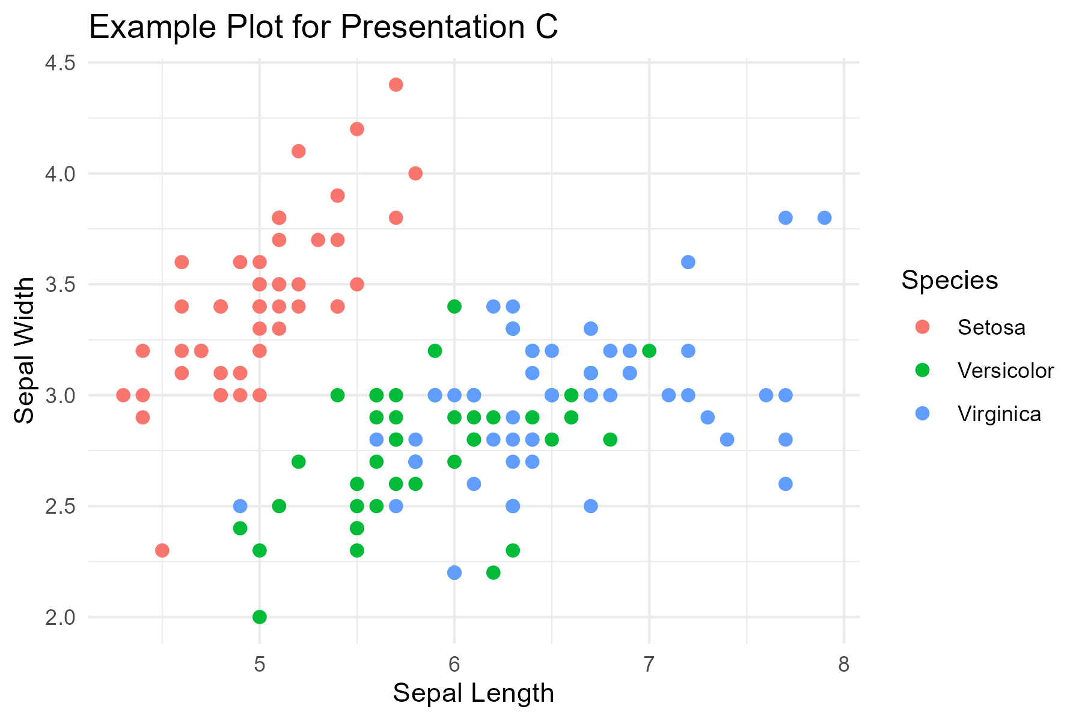
Example Plot C

